Slide 1
KK-01
Amanda Smith

Slide 2
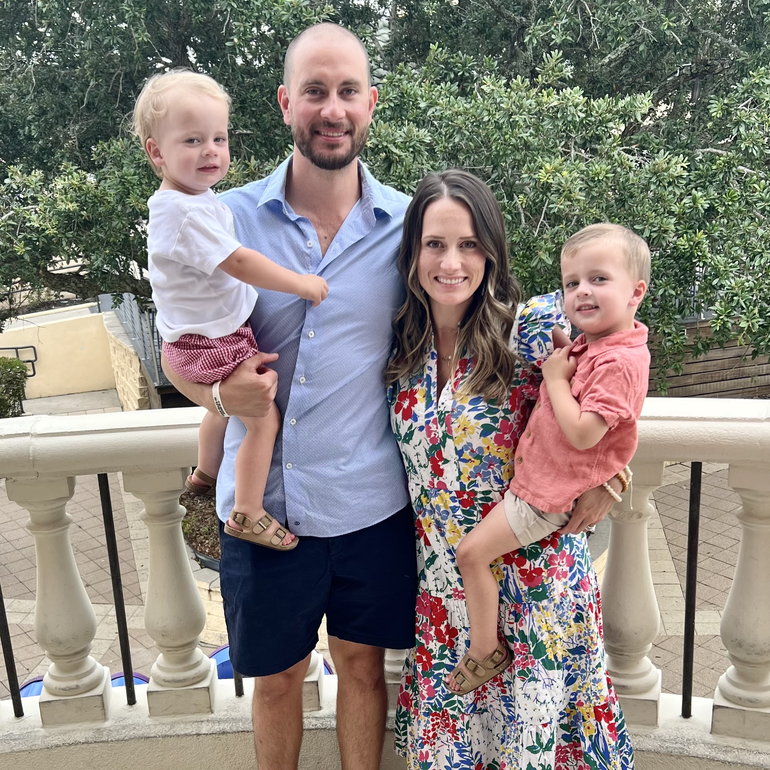
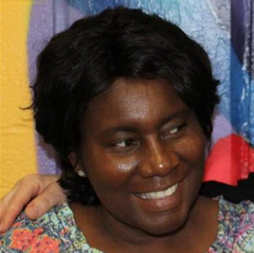
Meet The Teacher
Mrs. Amanda Smith, KK-01
I am from Memphis and am in my 12th year of teaching. I graduated with my Masters Degree in Elementary Education at Ole Miss. I taught Pre-K for 3 years and Kindergarten for 9 years. This will be my 6th year teaching at Richland. My husband and I have two boys- a 2 year old and a 4 year old. We also have 2 weenie dogs and a cat.
Our Assistant is Ms. Peete!
She has been at Richland for 16 years.

Slide 3
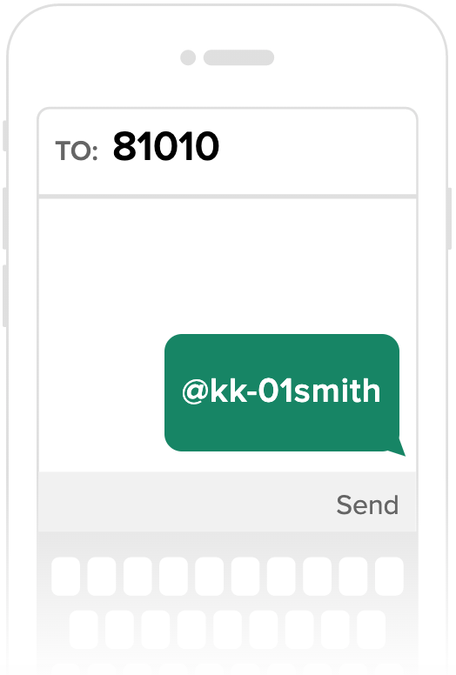
Contact Info
- We will communicate through the REMIND app!
This is where I will post all of my announcements.
- Here is how to join! →
*When you save your name in Remind, please put your child’s name in parenthesis.
Example: Beth Dycus (Caroline)
*If you have kids in other grades,
just put all of their names in parenthesis–
example: Beth Dycus (Caroline, Allison, Ben)

Slide 4
Contact Info
Cell: 901-833-8910
Please only use my cell if you have an emergency, last minute change in transportation, etc. Call the office if I do not respond.
Right Now: Please text me your child’s first and last name. This way I can search text messages for your # in case of emergency.
Email: smitha35@scsk12.org
School Office: 901-416-2148
ICE: always assume I do not have my phone on me

Slide 5
COMMUNICATION/ WEBSITE
My Website:
https://tn50000520.schoolwires.net/Domain/4174
CHECK THIS WEEKLY. It is updated on Fridays.
Please check my website before asking me!
This is how to save it to your favorites on your phone…
(see next slide)
Conferences:
twice a year (you will pick one),
or informal conference as needed

Slide 6
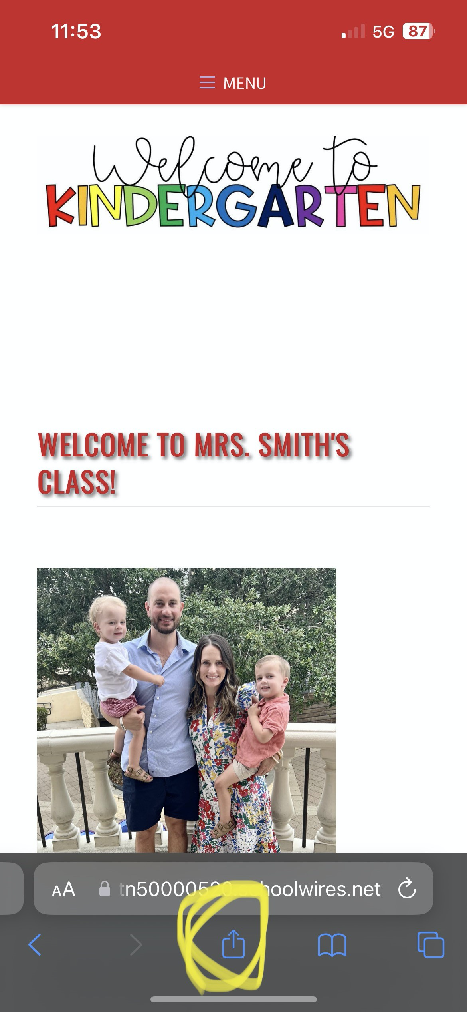
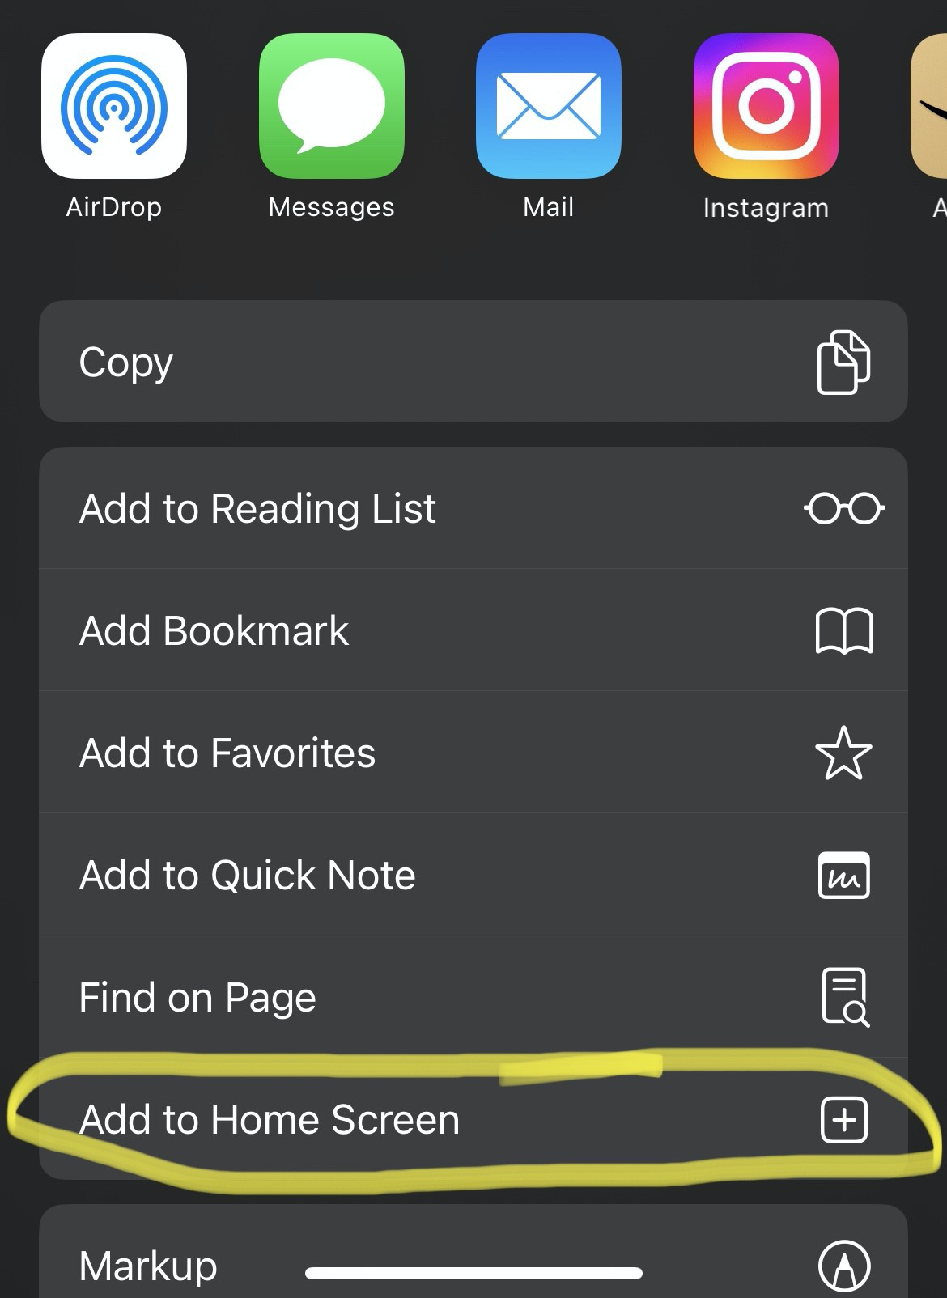
COMMUNICATION/ WEBSITE

Slide 7
Lunch & SNack
Lunch:
You may pack one or get a school lunch.
School lunch is FREE for all students.
If your child has a severe peanut allergy, they will sit at the peanut free table. LET ME KNOW TONIGHT!
Snack:
You will have 1 snack day/ month. (Please check my website under “Teacher Updates” for your day).
Bring 24 individually wrapped snacks on your day.
NO NUTS.
If you forget to bring snack on your day, bring the next day!
* Their snack day is also their “SHARE DAY.” They can bring 1 small toy, picture or item to share with the class during snack time.

Slide 8
Arrival & Dismissal
* School Hours→ 8:05-3:10
* Students can arrive at school as early as 7:45 to eat breakfast in the cafeteria.
* Students are tardy after 8:20.
* You may NOT check your child out after 2:30.
For safety–
Please make sure your child fist bumps me before you take them at dismissal.*

Slide 9
Arrival & Dismissal
* Regular school attendance is essential. Please make every effort to have your child at school on time each day. (We don’t want them getting a truancy letter or missing their morning journal!)
If your child will be absent from school, please call the school office (416-2148).
Please also text me that morning!
Return with a note for the office.

Slide 10
Arrival & Dismissal
* FIRST Staggered Day (8/7-10):
You may walk your child to the classroom and stay for a few minutes to get them settled in and take pictures ☺
* FIRST DAY with ALL students (8/14):
You may walk your child to the classroom again.
**YOU MAY NOT WALK THEM TO CLASS AFTER AUGUST 14th**
There will be teachers at the front to help them line up and walk to the room. ☺

Slide 11
Backpacks & BEE Binders
* BACKPACKS:
- Backpacks should be large enough to fit→
BEE Binder, Jacket, Change of clothes, ”Share” item on their day... without causing them frustration!
- NO ROLLERS
* Take Home Folders:
- These will go home everyday.
- Please take time to check for important information from school. Check the folder INSIDE their BEE Binder for notes from school/ finished class work.
- Remove work daily!

Slide 12
BRING EVERYDAY!
Change of UNIFORM clothes in backpack at all times (including socks) Change them with the seasons!
Backpack
TAKE HOME FOLDER- “STAR folder”
- Water Bottle WITH LID
* NOT disposable ones
* Must be LABELED
* MUST have WATER in it (no juice)!
Devices and headphones will be kept at school!

Slide 13
Curriculum
ELA: Wonders
(I also supplement Jan Richardson’s Next Step to Guided Reading during reading groups, as well as, Science of Reading)
MATH: enVision
SCIENCE/ SS: Inspire Science & embedded into curriculum

Slide 14
Journal
Journal writing occurs M-TH, first thing in the morning!
Through exposure to phonics skills and a variety of reading experiences, journal entries move from pictures and temporary spelling/ labeling→ toward more conventional writing.
*It is a great idea to have a journal for your child to have fun writing at home!
*Encourage ALL forms of writing!
*DO NOT tell them how to spell something!
(They may use inventive spelling: techr, tabl, frind)

Slide 15
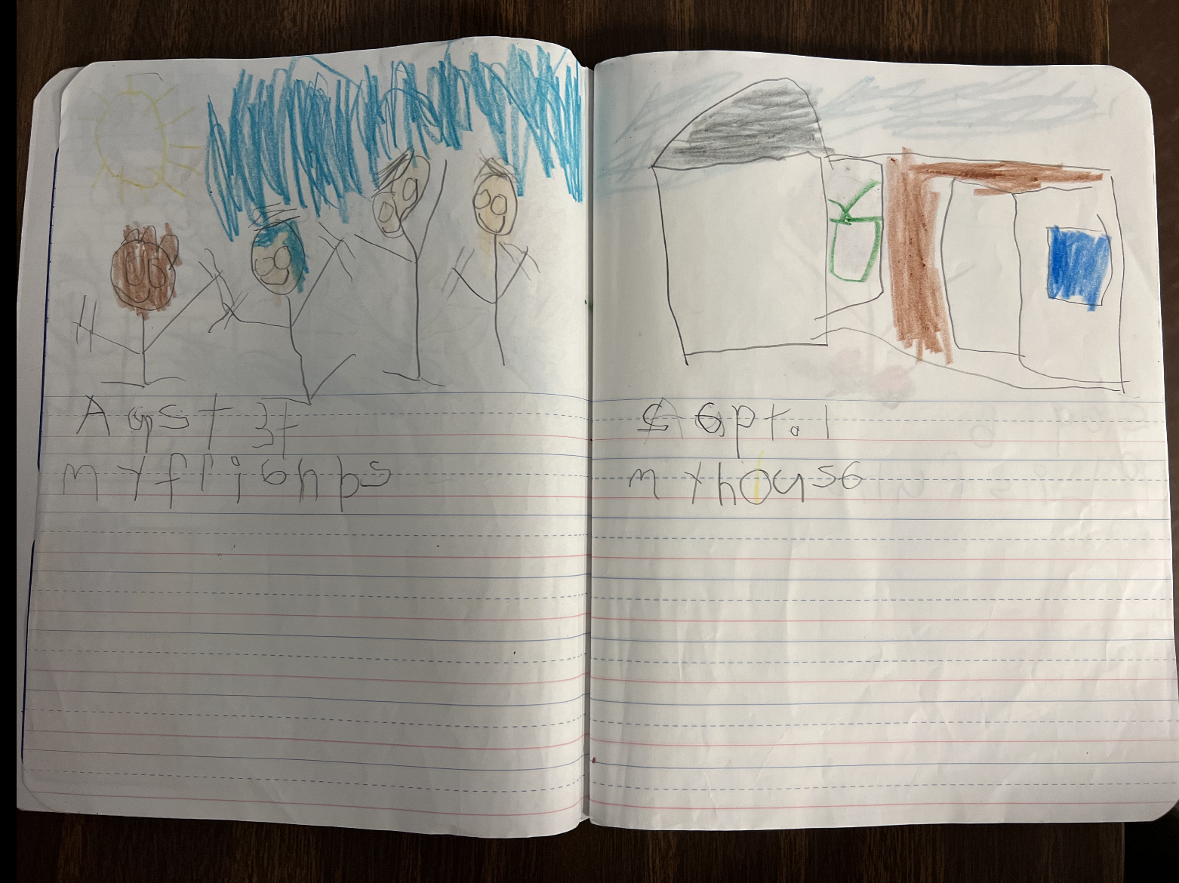
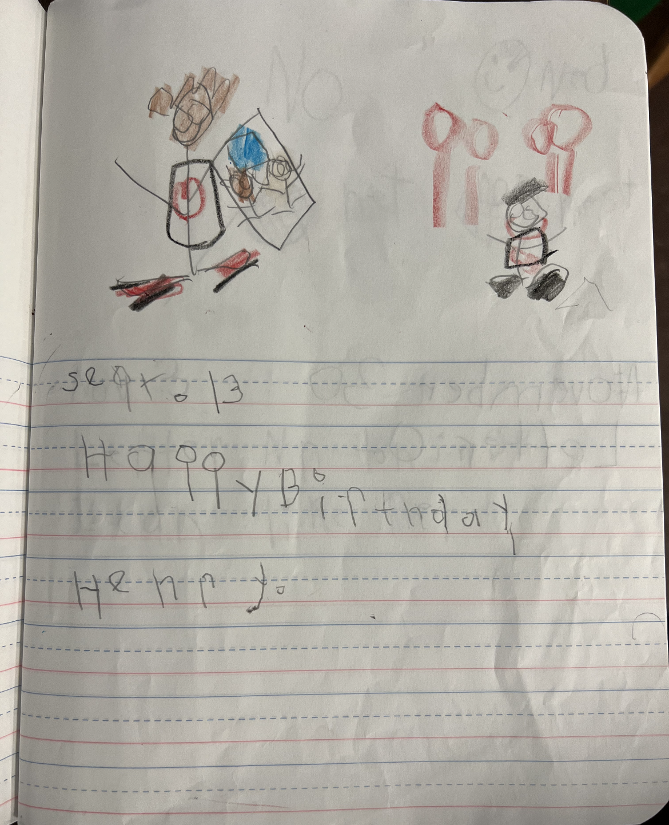
Journal

Slide 16
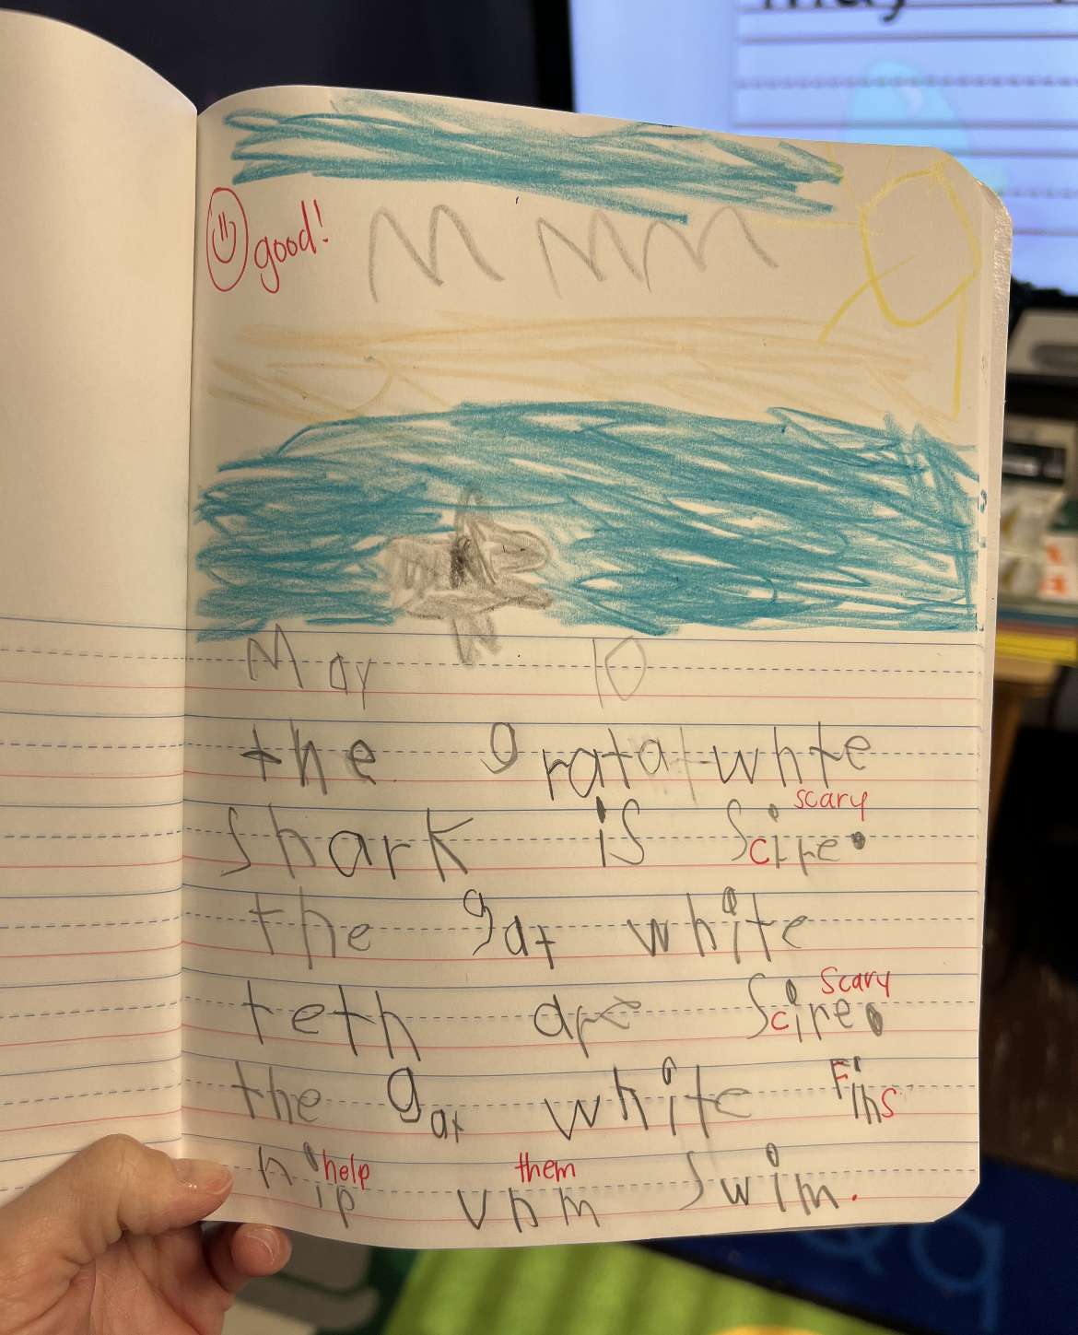
Journal

Slide 17
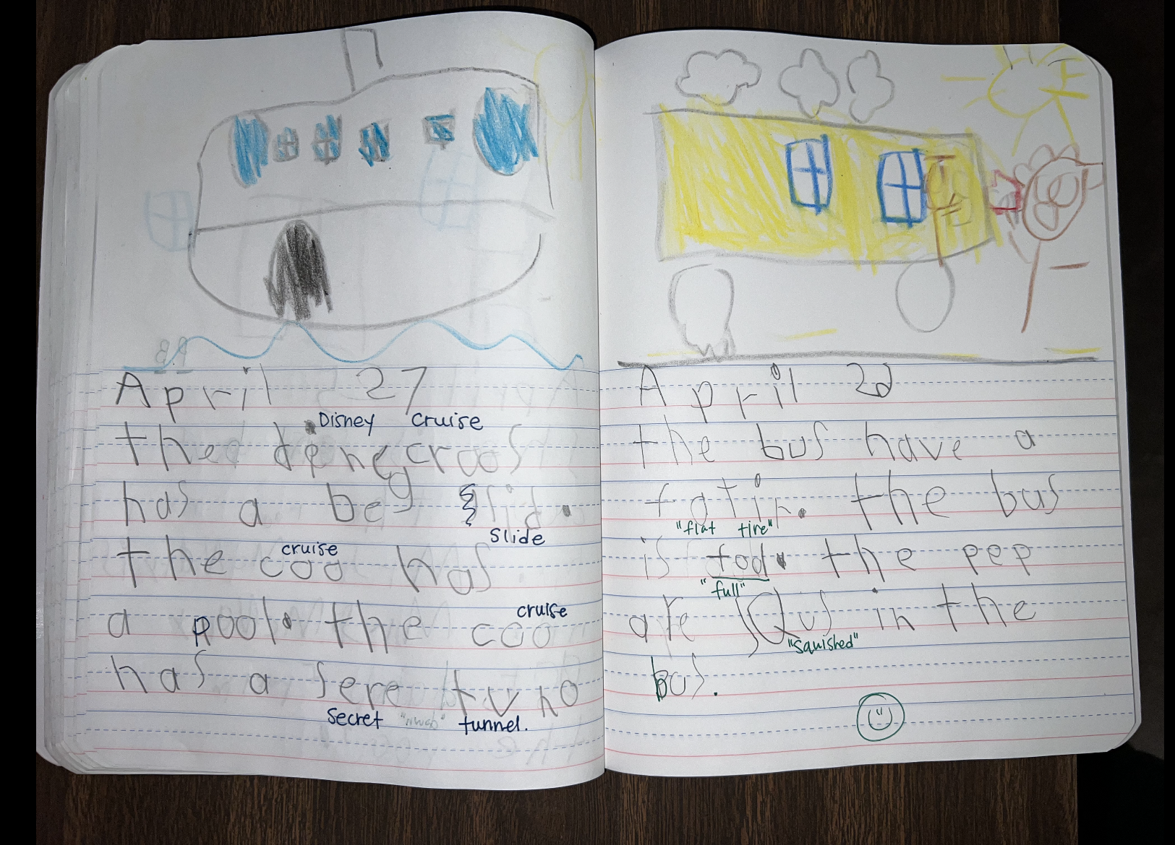
Journal

Slide 18
Homework
Kindergarten homework calendar is OPTIONAL, but highly encouraged to prepare them for 1st grade.
READ NIGHTLY
PRACTICE SIGHT WORDS (sight word ring)

Slide 19
GRADES
* Report Cards:
- Standards-Based Grading (M or X)
(I will send home a list of the ELA standards
for each Q in their BEE Binders… please look at these each quarter to make sure they are on track)
* Benchmark Assessments (i-ready, mastery connect)
* Informal Assessments
* Daily Calendar (Conduct)

Slide 20
Celebrations/ Class Parties
- Birthdays:
- Titles for Tomorrow, Special Snack Day,
Birthday Lunch) *No cupcakes/balloons*
2 Field Trips
Zoo in the Fall and Botanic or Farm in the Spring
- Thanksgiving Feast*
- Winter Party
End of Year
NEED ROOM PARENT TO HELP ORGANIZE PARTIES!

Slide 21
Uniform
*NO BLUE shirts
*NO BLUE polo dresses
* Shoes:
tennis shoes, sandals with back strap
*NO Crocs
*NO light up shoes

Slide 22
Other Important Info
Label personal items
lunch box, jackets, water bottle
Independence
tying shoes, zipping, opening milk, etc.
Please wear “no tie” shoes if they cannot tie yet!
Rest
we did away with nap last year, so please make sure your child gets plenty of sleep nightly. Bedtime should be BEFORE 8 for optimal rest throughout the week

Slide 23
Supplies
*
Any questions about the supplies?
Please do not get Bluetooth headphones, they need a cord.

Slide 24
8:05 Arrival
8:15-10:45 ELA
(Morning Meeting, Calendar Math, whole group ELA & reading groups)
10:50-11:20 LUNCH
11:25-11:55 RECESS *no parents*
12:00-1:00 MATH
1:00-2:00 ENCORE
2:05-3:00 BOOST/SNACK/SHARE
3:10 Dismissal (outside back door)
Schedule
ENCORE: coming soon
Spanish, Library, Art, Music, PE
Mon-
Tues- *NO ENCORE*
Wed-
Th-
Fri-

Slide 25
DON’T FORGET!
POPSICLES AT THE PARK, August 12th @ 9 - 10:30
OUR CLASS WEARS ORANGE!
BEFORE YOU LEAVE, Make sure you…
signed in w/ your name, email and phone #
filled out student papers & returned
signed up for a staggered day
make sure the office has everything for registration → (3 people)
If you haven’t brought supplies, please make sure you do on their staggered day.
Take an item from the giving tree before you leave ☺

